Slide 1

Topic Solving the Dynamic Weapon Target Assignment Problem by an Improved Multi objective Particle Swarm Optimization Algorithm
PROLAY KAYAL, 2311MC10
SOVAN PAL, 2311MC18
MINTU ADAK, 2311MC22
SURAJ KUMAR, 2311MC17
MTECH IN MATHEMATICS AND COMPUTING
SESSION : 2023 - 2025

Slide 2
agenda
Introduction
DWTA Model
DWTA Model Construction
DWTA Flow Chart
Results
Future Work
Conclusion

Slide 3
INTRODUCTION
The Weapon Target Assignment (WTA) problem is a critical issue in military operations.
Primary objective is to optimize the allocation of weapon units to enemy targets in order to achieve the most effective strike outcome.
Dynamic weapon target assignment (DWTA) is an effective method to solve the multistage battlefield fire optimization problem, which can reflect the actual combat scenario better than static weapon target assignment (SWTA).
The DWTA model considers maximizing combat benefits and minimizing weapon costs, along with resource, feasibility, and fire transfer constraints.
IMOPSO incorporates various learning strategies for dominated and non-dominated solutions

Slide 4




DWTA MODEL
Mathematical Model of Multi-objective Optimization Problem:
The DWTA problem is described as multistage SWTA problem:
Objective function of DWTA Model:
Expected Damage of Targets at each stage:
Ammunition Consumption:

Slide 5

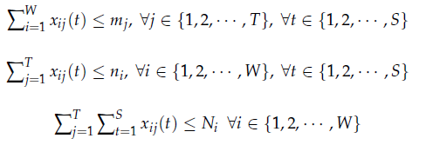

Dwta model construction
Multi-objective DWTA model is constructed as follows:
Such that

Slide 6
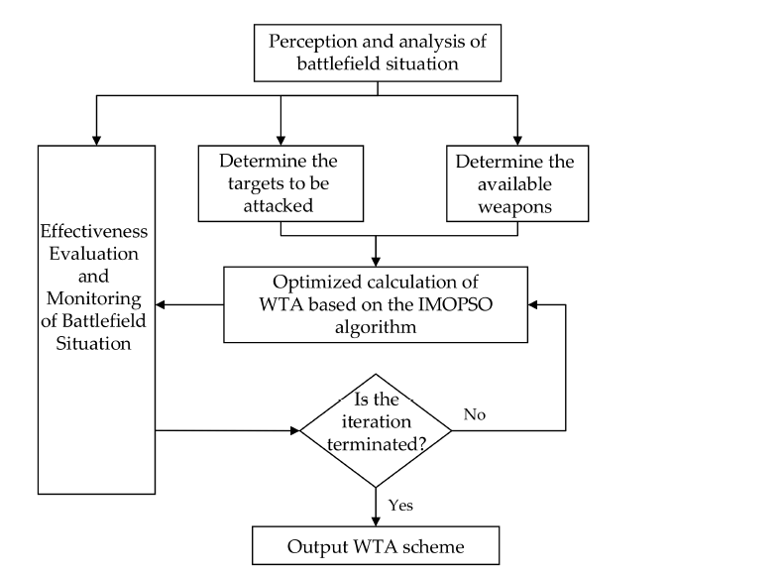
Dwta flowchart
Decision Making Process of DWTA

Slide 7
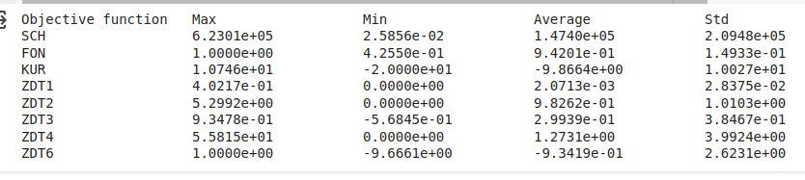
RESULT of imopso
Statistical Result of IMOPSO with different objective functions

Slide 8
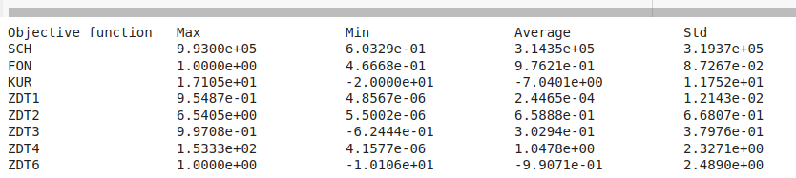
Result of improved imopso:
Statistical Result of Improved IMOPSO with different objective functions

Slide 9
FUTURE WORK
Extension to Higher-dimensional Problems with more than two objective optimization problems
IMOPSO will be applied to solve various multi-objective optimization problem models beyond DWTA, addressing real-world challenges in diverse domains.
Comparative studies will be conducted with additional intelligent algorithms.

Slide 10
CONCLUSION
Algorithm designed for multi-objective DWTA optimization.
Enhances learning, global exploration, and solution diversity.
Validates effectiveness through benchmark functions and DWTA modeling.
Superior convergence and distribution of non-dominated solutions.
Outperforms MOPSO, NSGA-II, and MOEA/D in experimental comparisons.
Especially effective for large-scale mixed integer programming problems.

Slide 11
Thank you

